Slide 2
WORD JUMBLE RACE

Slide 3
When you want to watch the wildlife programme on TV at night.
1 How do you ask for permission?
2 Who do you ask for permission?

Slide 4
UNIT 3: WILD LIFE
Lesson 6
SPEAKING
• Asking for permission

Slide 5
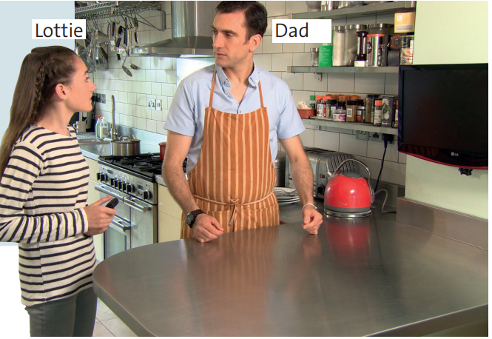
What is the situation?

Slide 6
EXERCISE 2.
1 watch that wildlife programme on TV
2 It’s really good.
3 it’s time for dinner
4 watch TV later
She can watch the TV programme later.

Slide 7
EXERCISE 3. Matching
1 - b. go to the cinema with Hana
2 - d. There’s a really good film
3 - a. I think you’ve got homework
4 - c. go at the weekend

Slide 8
Practice
dialogue
the

Slide 9
EXERCISE 4. Matching
Requesting permission
b. watch TV
1 Is it OK if I / we ………………........ ?
d. go to a friend’s house
e. use the computer
b, d, e
2 Can I / we / you ……………………. ?

Slide 10
EXERCISE 4. Matching
Giving permission
Yes, of course you can.
Refusing permission
No, I’m afraid you can’t.
3 I’m sorry, but …………………...
a, c, f

Slide 11
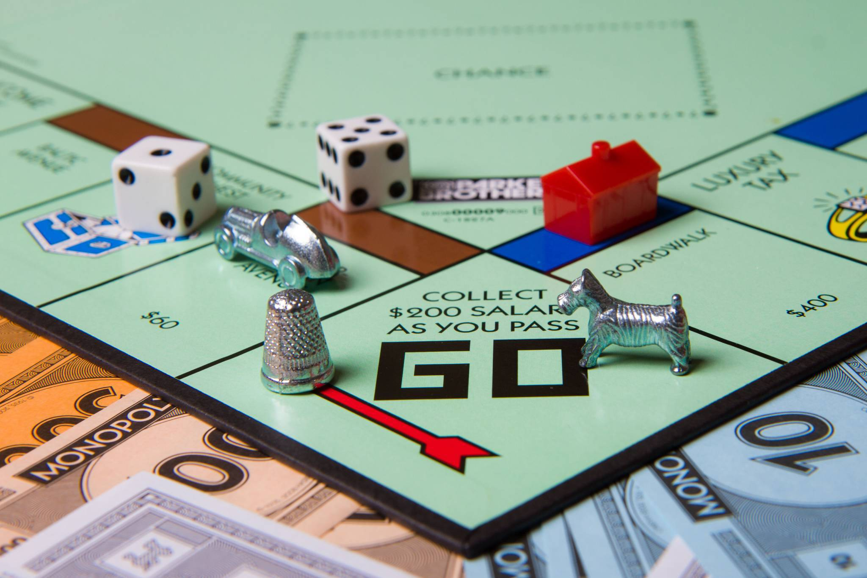
Board Game

Slide 12
homework
- Do exercise in Student book page 59
- Prepare for the next lesson:
Writing – Animals in danger.

